Slide 1

Cross-sell analytics
T3- Linear boost

Slide 2
What is Cross-Selling?
Cross-selling in insurance is the act of promoting products that are related or complementary to the one(s) your current customers already own or use. It is one of the most effective methods of marketing.

Slide 3

Smart Question
Which factors suggest whether an existing customer would be interested in vehicle insurance?

Slide 4
About the Dataset
Whether a customer would be interested in an additional insurance service like vehicle Insurance is extremely helpful for the company because it can then accordingly plan its communication strategy to reach out to those customers and optimize its business model and revenue. We have following information to assist our analysis: demographics (gender, age, region code type), Vehicles (Vehicle Age, Damage), Policy (Premium, sourcing channel) etc.

Slide 5

Exploratory Data Analysis

Slide 6
For EDA
Analyse the target variable – “Response” from the customer
Remove any outliers from the data
Observe the trend of all variables w.r.t target variable
Turn the categorical variables into factor
Perform t-Test for all continuous variables
Perform chi-square test for categorical variables w.r.t response
Graphs used:
Histogram
QQ-plot
Boxplot

Slide 7
How age of a person and their vehicle impacts response?

Slide 8
Which region has the most positive response?

Slide 9
How are premium and customer association are distributed for response?

Slide 10
Do customers with vehicle damage and an existing insurance impact response?

Slide 11
Communication Strategy by Response

Slide 12
Do males/females with a driving license respond?

Slide 13
Hypothesis Testing

Slide 15
t-Test

Slide 16
t-Test - 1

Slide 17
t-Test 2

Slide 18

χ 2 test
The Chi-Square test of independence is used to determine if there is a significant relationship between two nominal (categorical) variables. The frequency of each category for one nominal variable is compared across the categories of the second nominal variable.

Slide 19
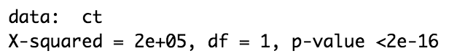
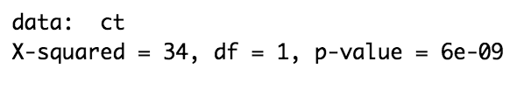
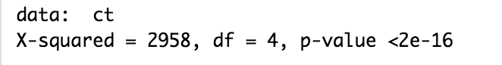
χ 2 test - 1
chi^2 test for categorical variables - Gender, Driving License, Region Code, Previously Insured, Vehicle Age, Vehicle Damage, Response.
Response: Gender
Response : Driving License
Response : Region Code

Slide 20
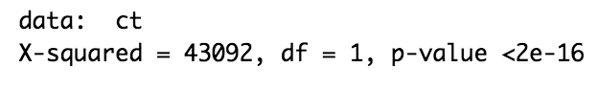
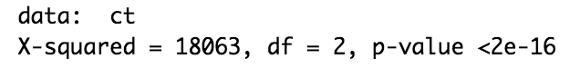
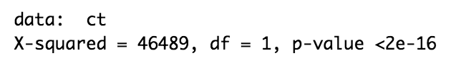
χ 2 test - 2
Response: Previously Insured
Response : Vehicle Age
Response : Vehicle Damage

Slide 21
Does correlation concur?
A correlation matrix is simply a table which displays the correlation coefficients for different variables. The matrix depicts the correlation between all the possible pairs of values in a table.
For our data, vehicle_damage, previously_insured and vehicle_age have high correlation.
Positive Correlation: vehicle_damage and vehicle_age
negative correlation: previously_insured

Slide 22
Questions?

